Slide 1
Log into UNET (https://portal.unos.org).

Slide 2
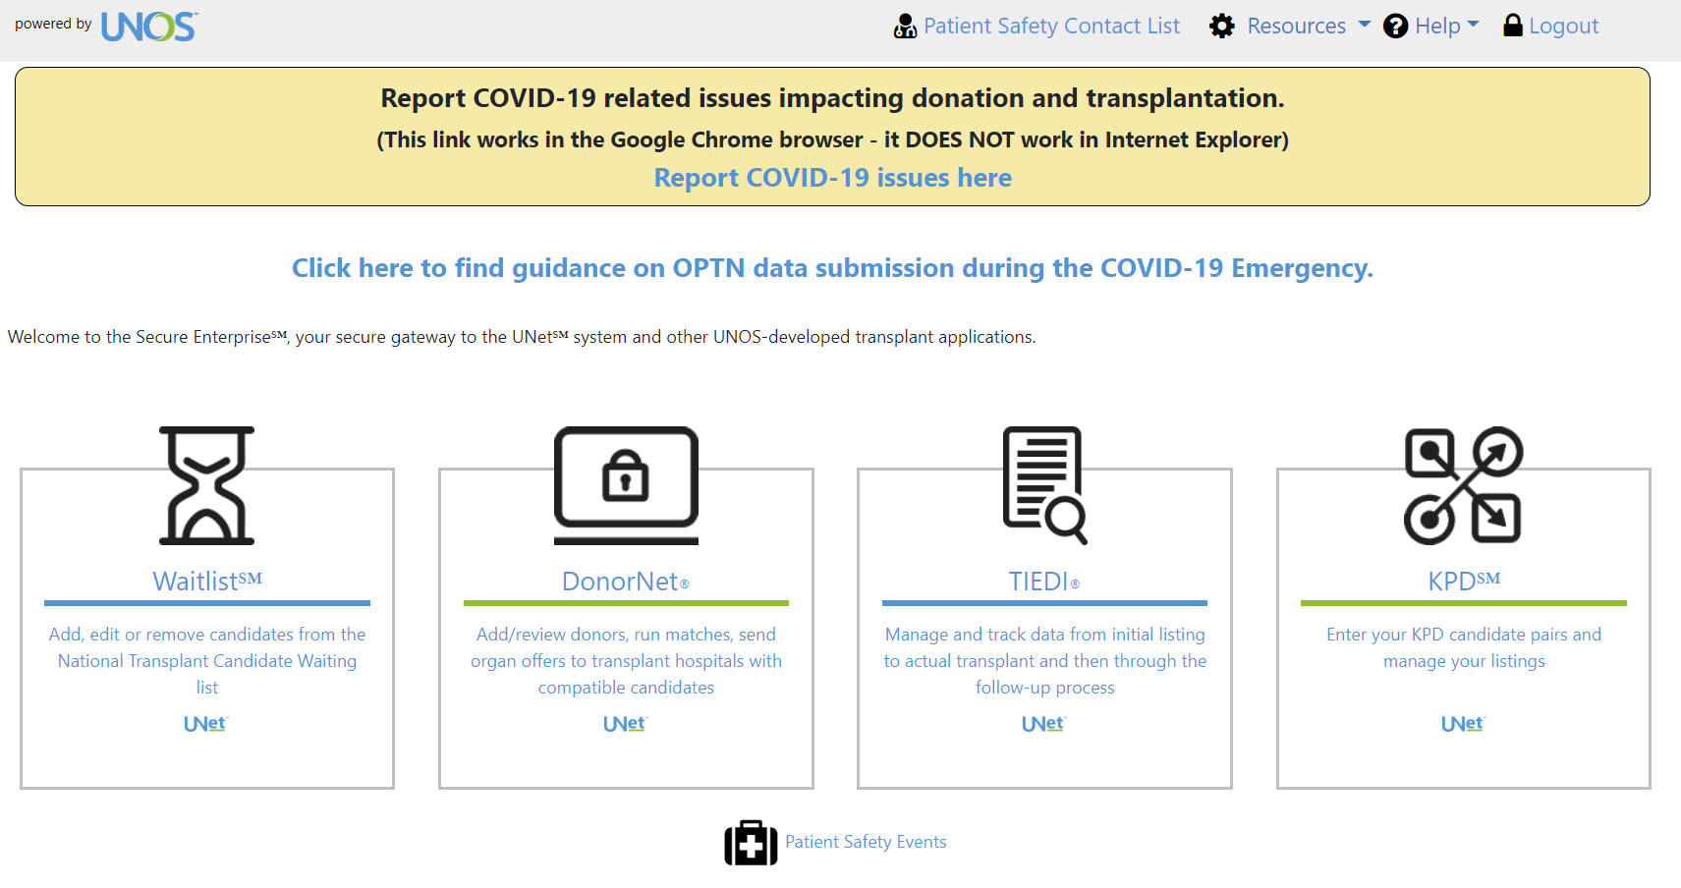
Navigate to TIEDI

Slide 3
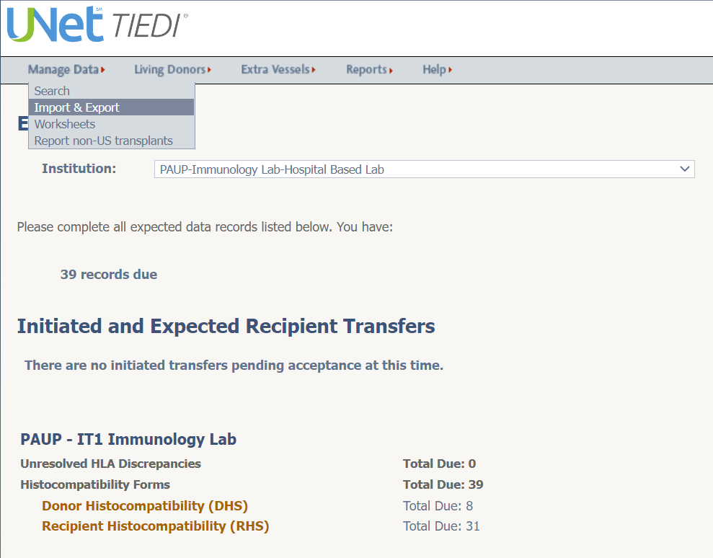
Under the “Manage Data” tab at the top right, click on “Import & Export.”

Slide 4
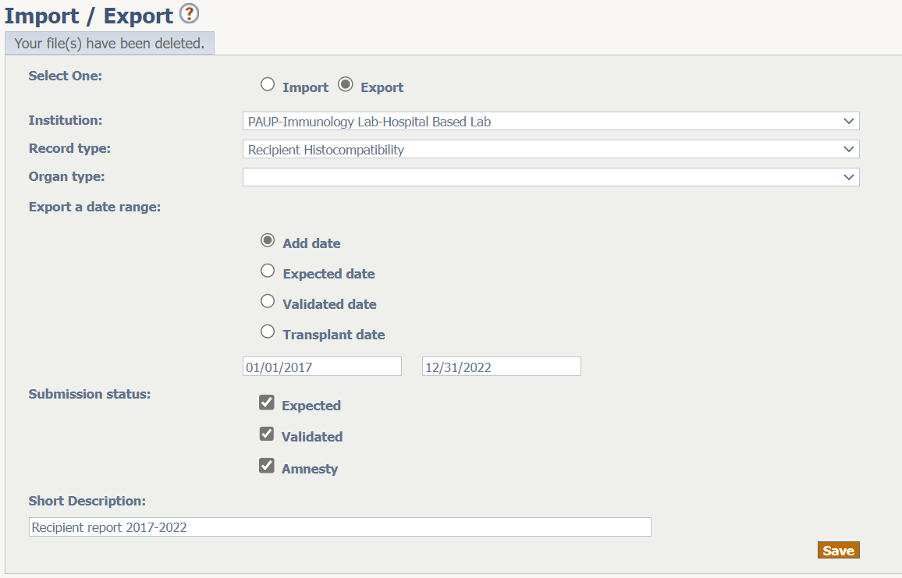
Export recipient info by setting up the screen like this:
You might have more than one selection here – chose the one for the HLA lab, not the transplant program.
Click “Save.”

Slide 5
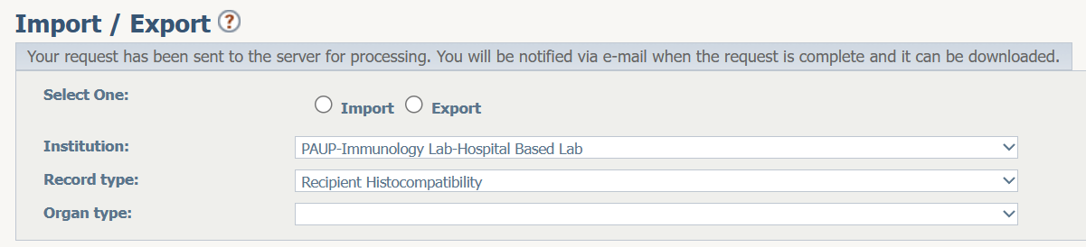
You should get a screen like this. I sometimes get a notification by email, otherwise just log back into TIEDI the next day.
But don’t go yet! You still need to export the donor report.

Slide 6
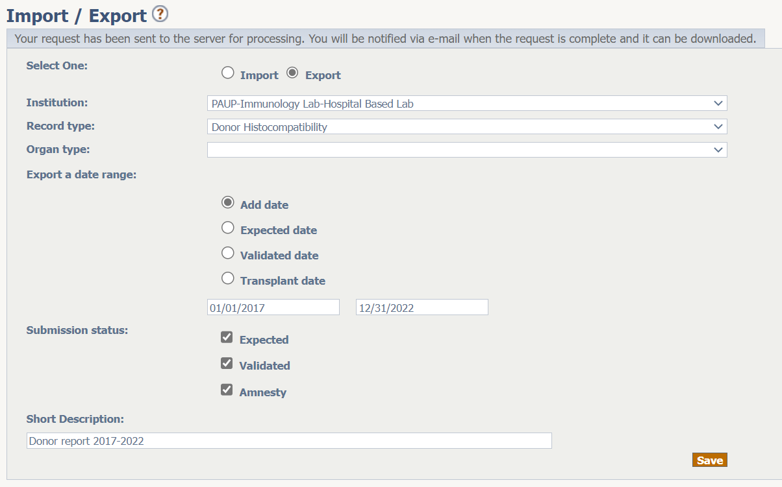
Back to the same screen, set up the report like this now.
Click “Save” again and you will be told the report will be ready later.

Slide 7
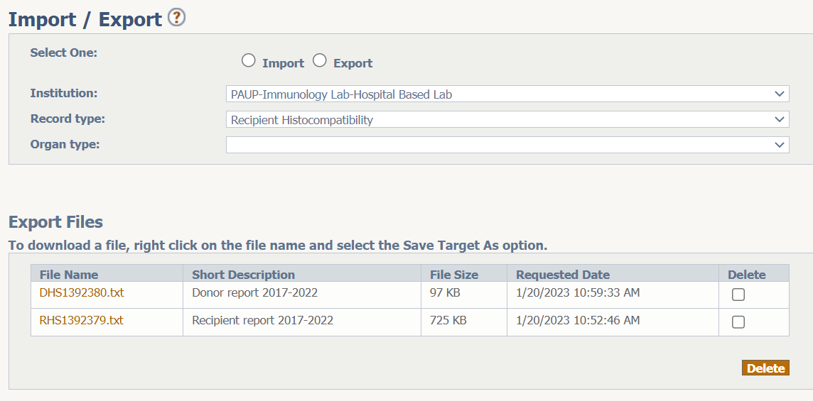
The next day you should find 2 files containing the records you requested.
Download both and use R script to process them for use in extracting data from your LIS.

